Slide 1
#CODEID
03052020
>>> Programming your design model
a crash course on Grasshopper Python programming application in architecture

Slide 2
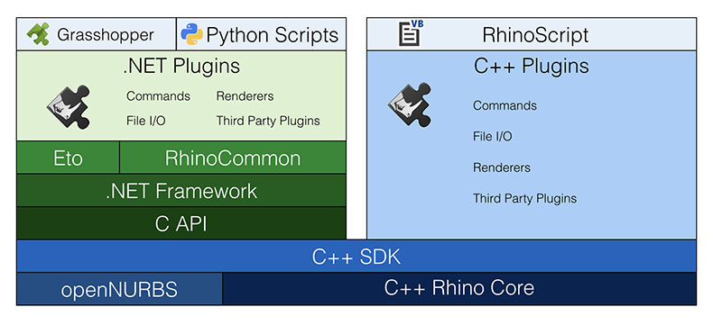
#CODEID
02052020
rhinoscriptsyntax
>>> Rhino Stack Diagram

Slide 3



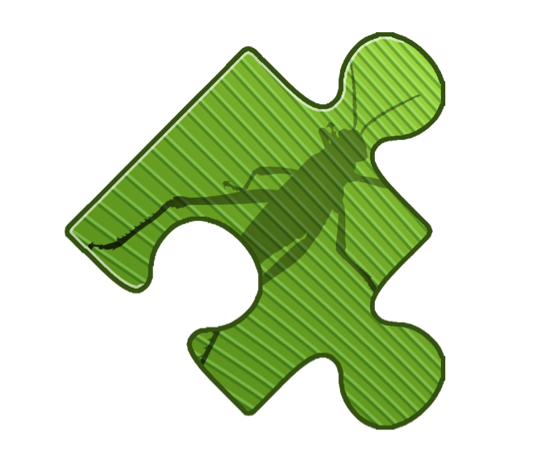
#CODEID
03052020
+
+
>>> What’s next?

Slide 4
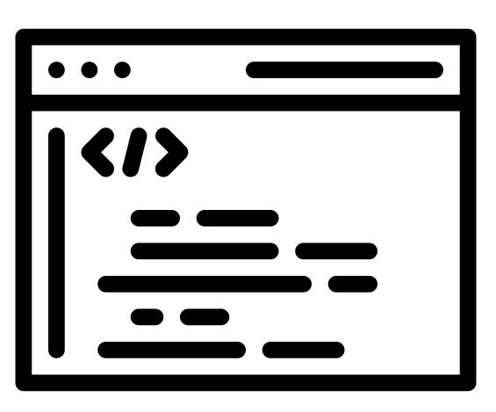
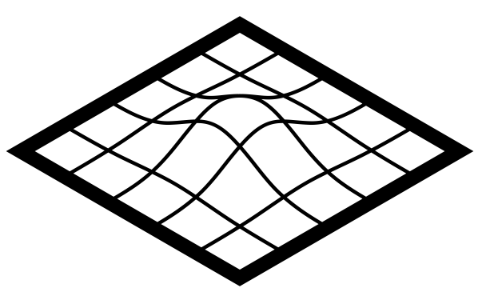
#CODEID
03052020
+
+
>>> Programming Paradigm

Slide 5
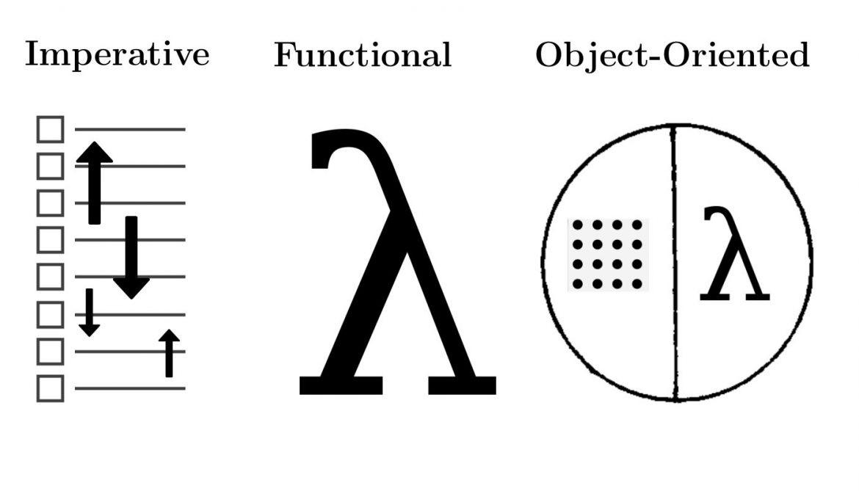
#CODEID
03052020
>>> Programming Paradigm
is simply a way of writing a program. In our case,a program that will generate our design

Slide 6

#CODEID
03052020
variable
>>> Imperative
variable

Slide 7

#CODEID
03052020
variable
loop
>>> Imperative
Variable, loop

Slide 8

#CODEID
03052020
variable
loop
conditionals
>>> Imperative
Variable, loop, conditionals

Slide 9
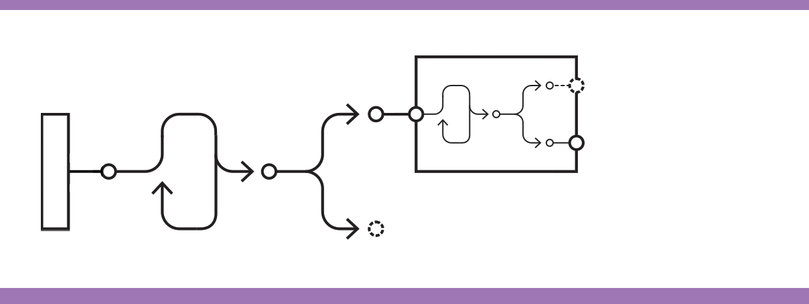
#CODEID
03052020
variable
loop
conditionals
function
>>> Functional
Variable, loop, conditionals, function

Slide 10
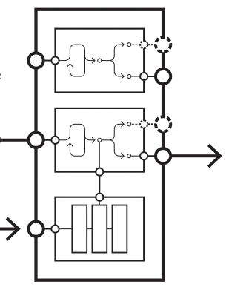
#CODEID
03052020
Class (object)
variable
loop
conditionals
function
>>> Object-Oriented
Variable, loop, conditionals, function, class

Slide 11
#CODEID
03052020
>>> Remember!
Python & IronPython is object-oriented language.
Rhino & Grasshopper SDK is written in C#, which is also object- oriented language.

Slide 12
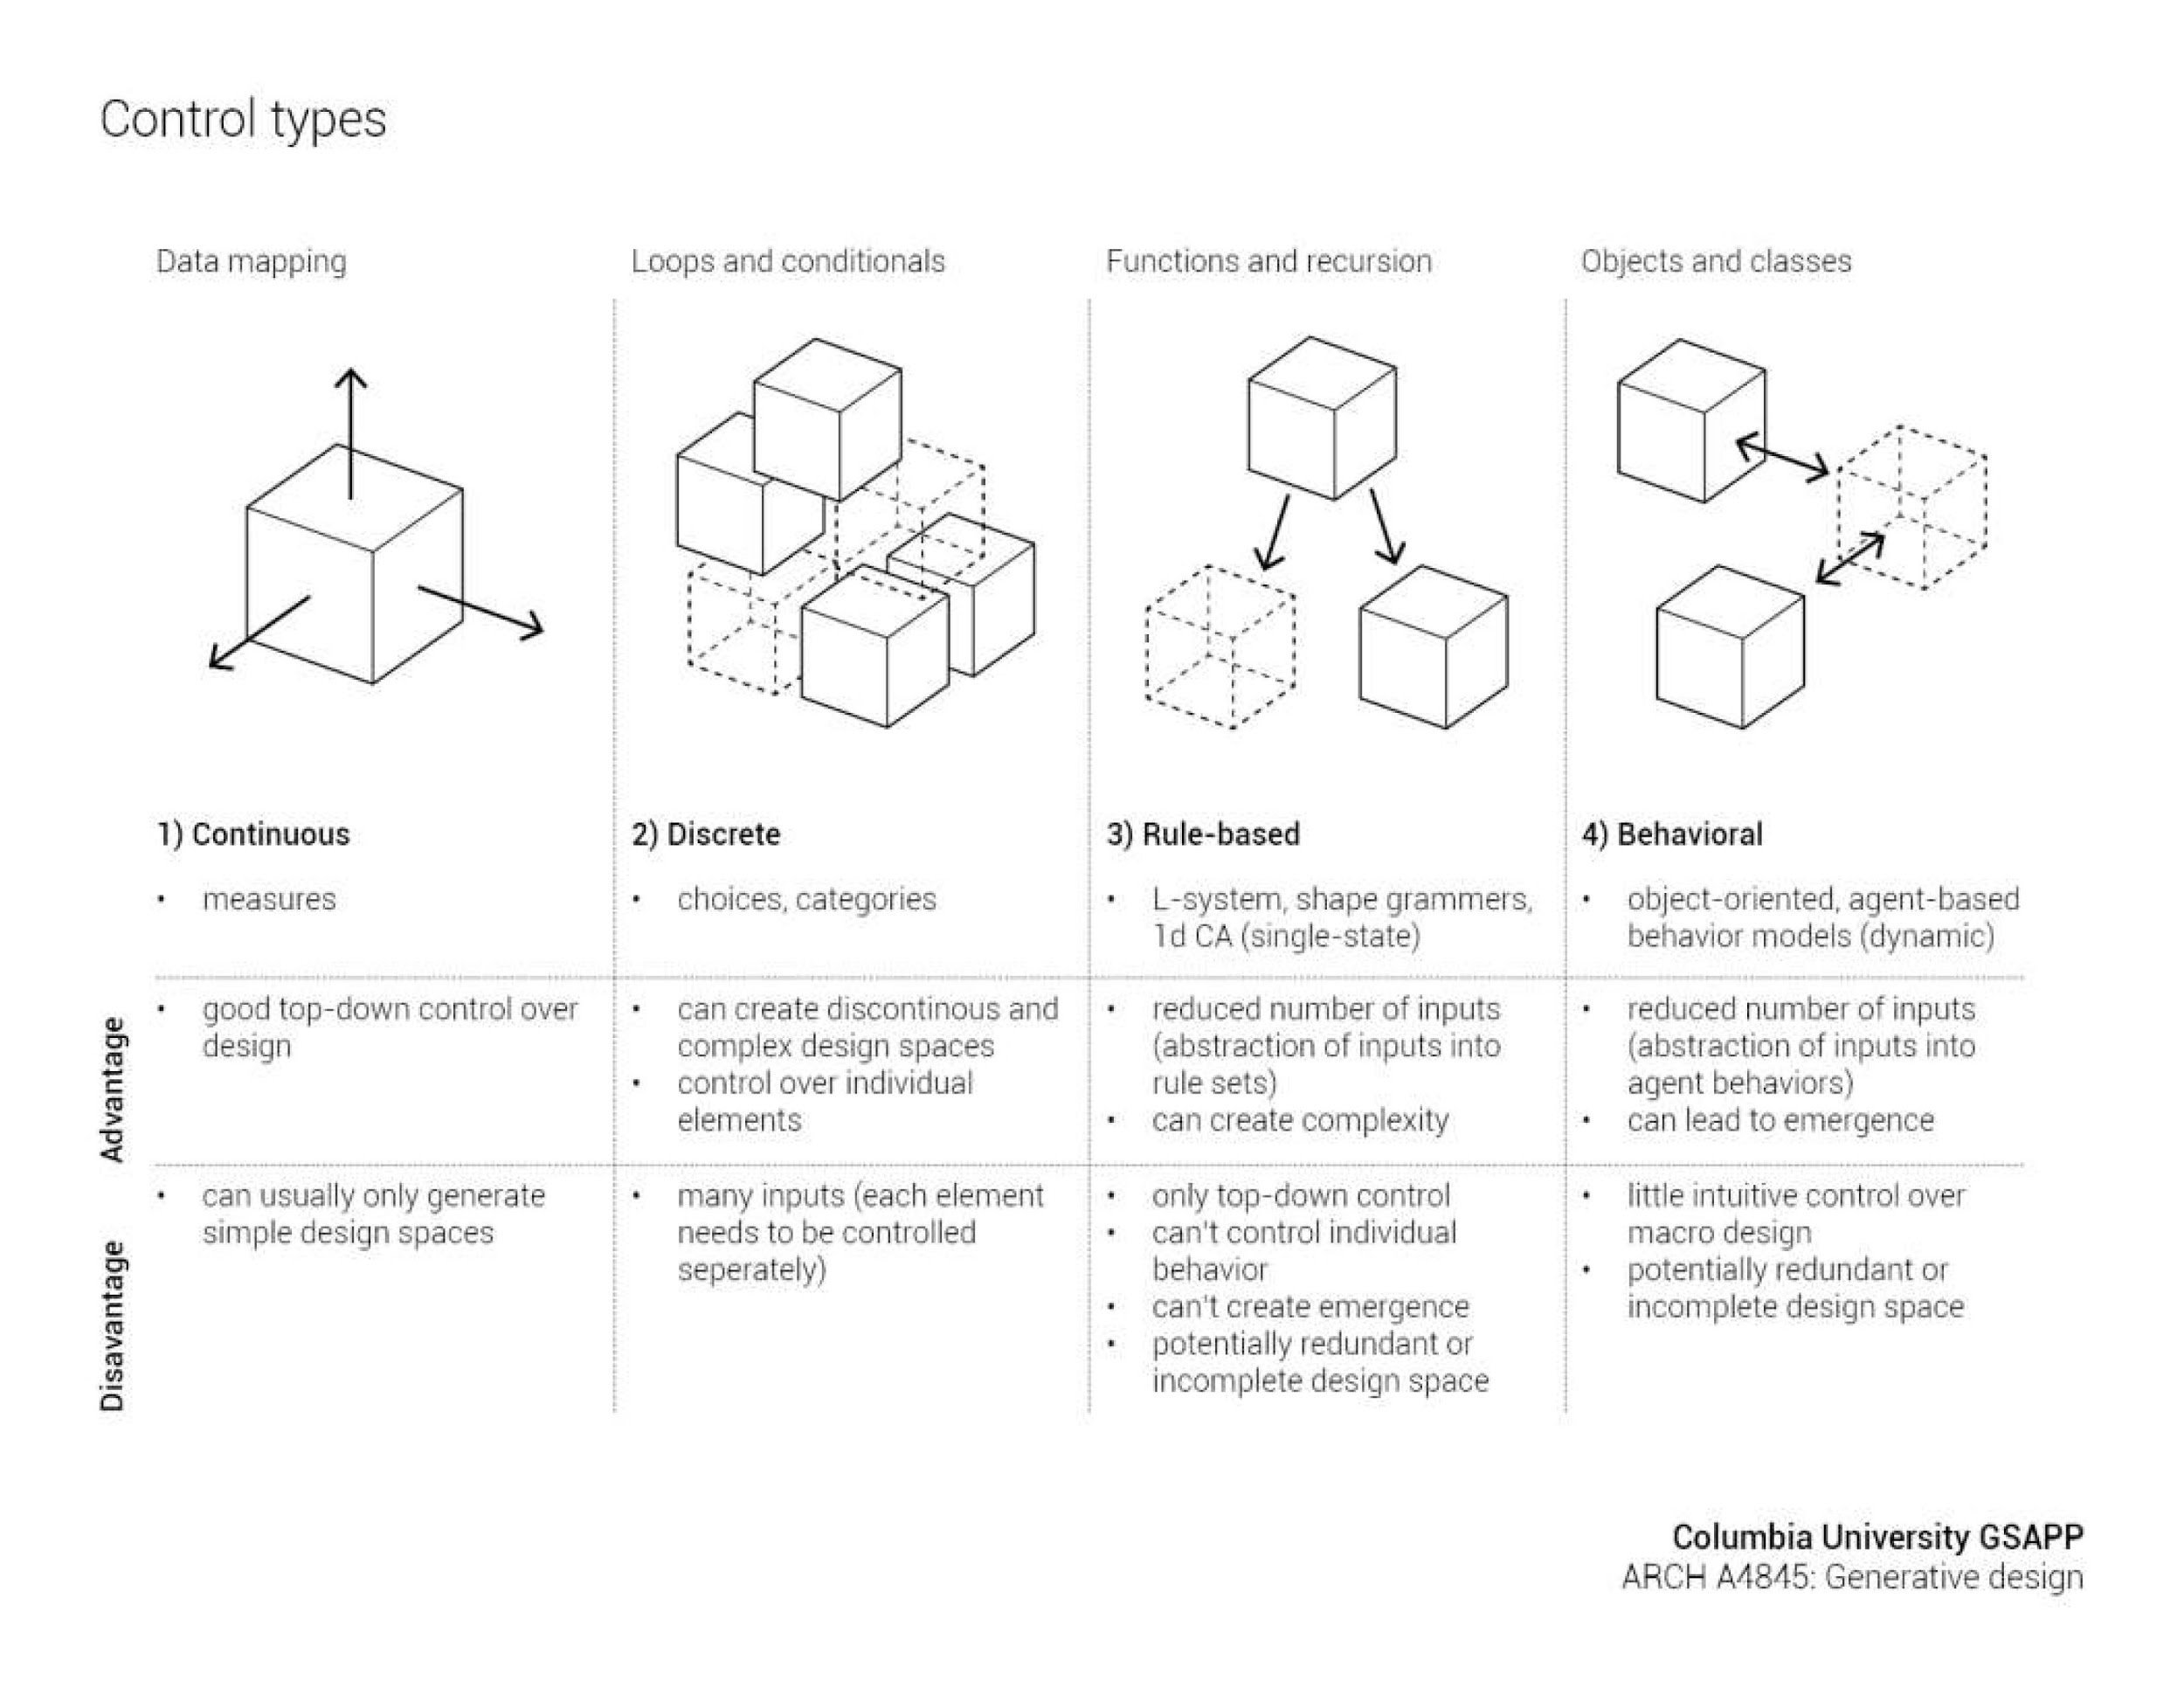
#CODEID
03052020
>>> Computational Strategies

Slide 13
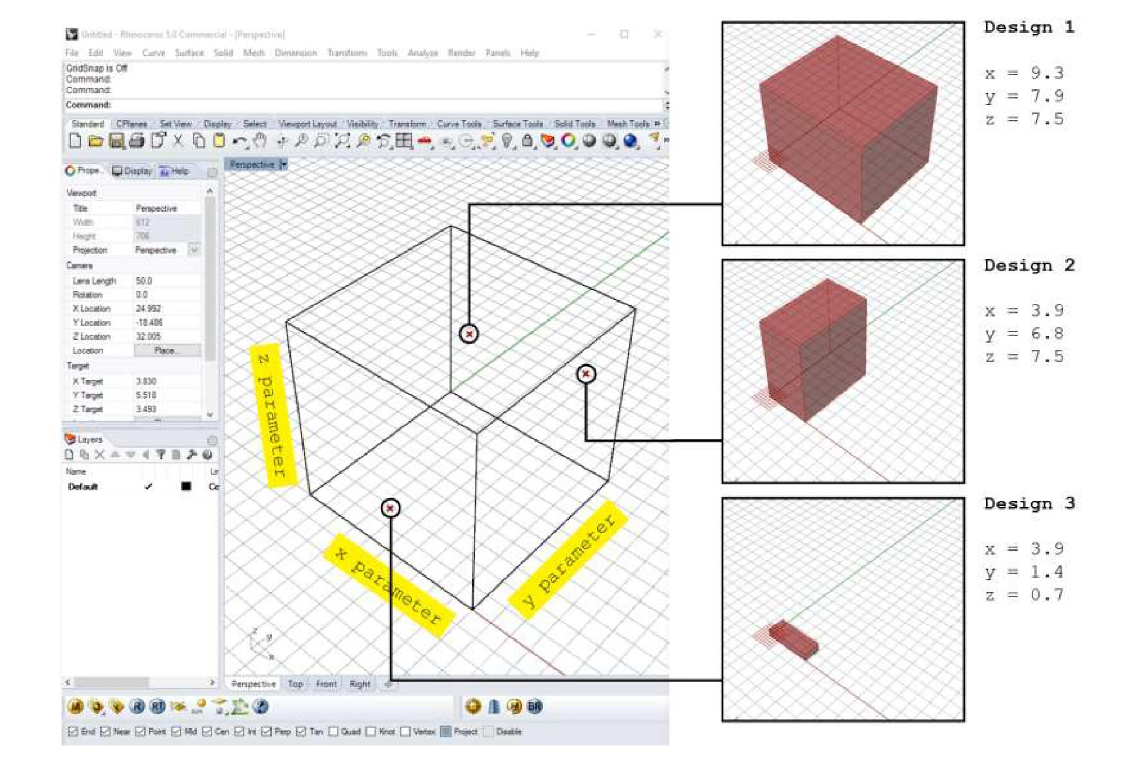
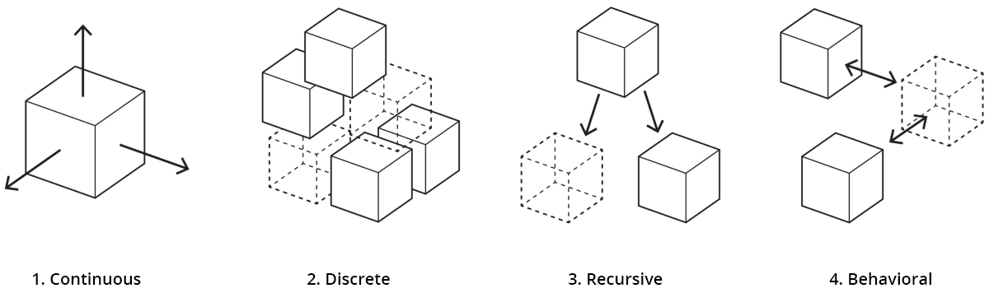
#CODEID
03052020
>>> Continuous

Slide 14
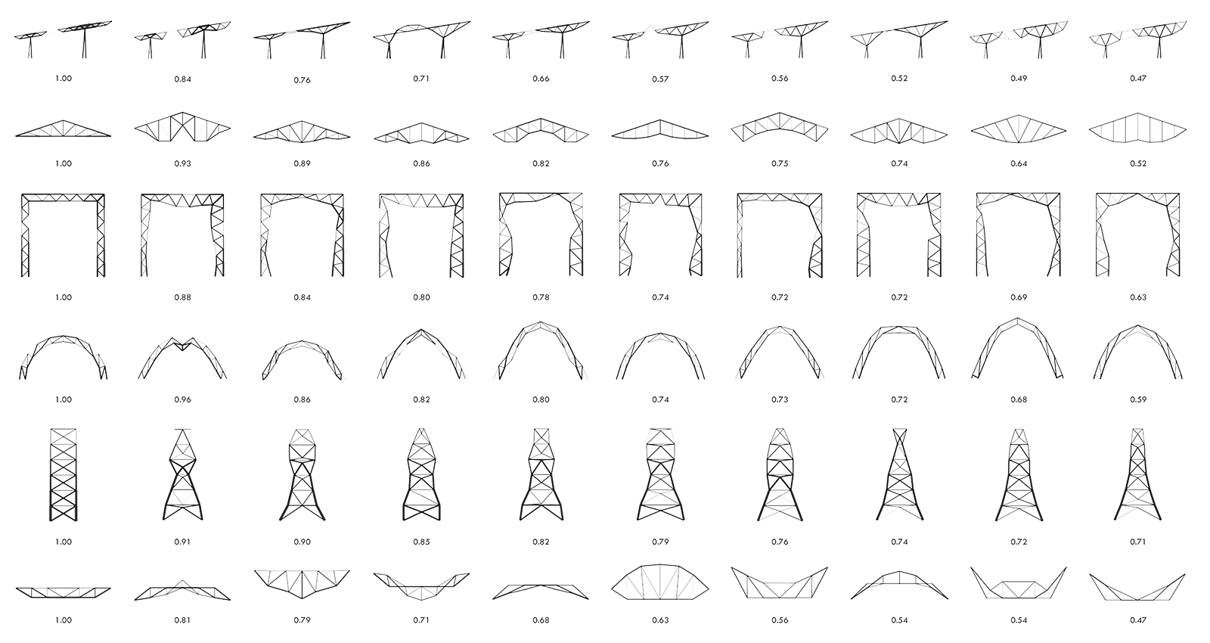
#CODEID
03052020
>>> Discrete

Slide 15
#CODEID
03052020
>>> Rule-Based

Slide 16
#CODEID
03052020
>>> Rule-Based

Slide 17
#CODEID
03052020
>>> Behavioural

Slide 18
#CODEID
03052020
>>> Focus:Recursive

Slide 19
#CODEID
03052020
>>> Focus:Recursive

Slide 20
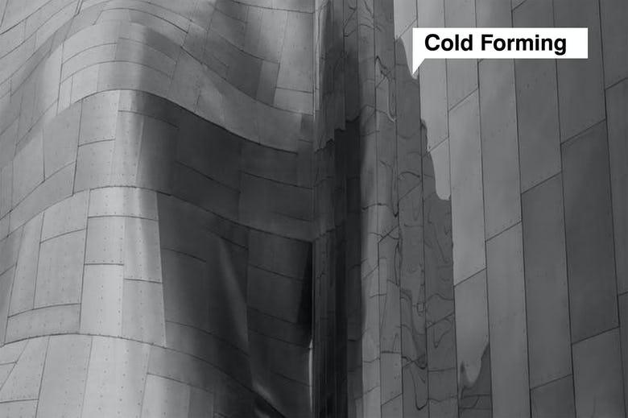
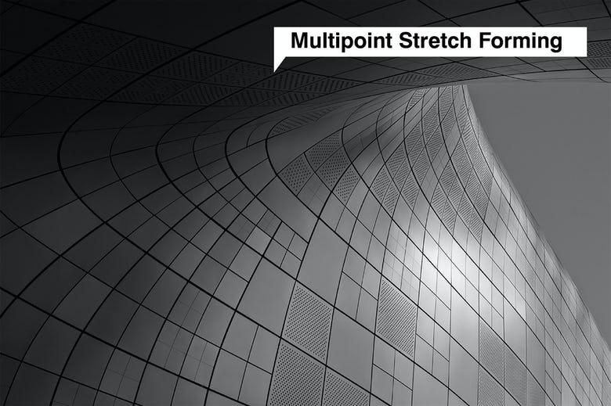
#CODEID
03052020
>>> Application:Facade Subdivision

Slide 21
#CODEID
03052020
>>> Let’s take a break and write some code!

Slide 22
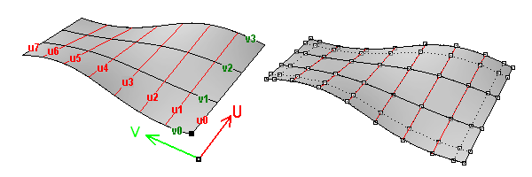
#CODEID
03052020
>>> Parametric Surface
https://developer.rhino3d.com/guides/general/essential-mathematics/parametric-curves-surfaces/

Slide 23
#CODEID
03052020
Sources:
https://medium.com/generative-design/introduction-to-computational-design-6c0fdfb3f1
https://medium.com/better-programming/programming-paradigms-object-oriented-vs-procedural-f89eda302b0e
https://www.slideshare.net/danilnagy/sp18-generative-design-week-1-introduction?from_action=save
https://www.azahner.com/blog/efficient-fabrication-of-double-curves-in-architecture
https://towardsdatascience.com/covid19-top-7-online-interactive-simulations-curated-fa4282889875
>>> thank you

